Slide 1

Quantum Computing Companies Stock Prices
Andrew Guilette, Lucas Thormann

Slide 2
Project Statement / The Question
Our objective is to design then evaluate a model capable of predicting future share prices of predominant, publicly traded companies on the NASDAQ Stock Market, centered around quantum computing technologies. The resulting model may provide insight into market trends surrounding this emerging industry.
Could we develop a system capable of forecasting future share price of a specific company? In other words, could we make a money printing machine that go brrrrr.

Slide 3
Description of the data
https://www.kaggle.com/datasets/nourajo/quantum-computing-companies-stock-data
The dataset is 136,518x7 with columns representing date, opening price, high, low, closing price, adj close, volume, and ticker. The data spans multiple years for over a dozen quantum computing related companies.
The two most valuable components of this data are the adjusted close values and their associated dates for each company.
The adjusted closing price amends a stock's daily closing price to reflect that stock's value after accounting for any corporate actions. It is often used when examining historical returns or doing a detailed analysis of past performance.

Slide 4
Exploratory data analysis
After exploring this data using built-in methods such as ".info()" & ".describe()" we discovered that the raw csv was fairly crude.
We decided that it would be best for our future training & testing efforts if we were to only work with a subset of this data.
In consequence of further exploration it was clear that even a subset of this data would need to be cleaned & normalized.

Slide 5
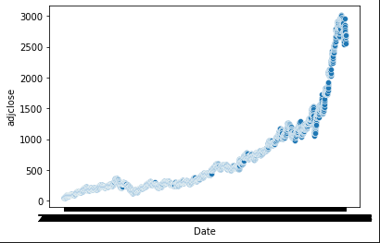
Data preprocessing
We decided to trim the data down into three different data frames that represent the share price & all associated data of our three favorite companies in the set.
After further exploration we decided that we would use all of the associated data of a single company in order to develop our models.
Due to Google's data being robust and it's trend line being relatively homogenous we chose it to be our play thing.

Slide 6
Data preprocessing
Once we limited the breadth of the data we began to clean it & normalize it.
We achieved normalization by scaling the data's features.
Feature scaling is a way to normalize data such that it increases the performance of some machine learning algorithms.
We used the MinMaxScaler to scale the data within a range of 0 to 1.
This was required since the data couldn't be used to train a model to accurately predict futures in its raw form.
We then split the data into two different data sets.
The train set is the sample of data used to fit the model. The test set is used for the final evaluation after the model is completely trained with the train set.

Slide 7
Review of our approaches
Since similar technology exists, we used related resources to research which models have proven to be most successful in predicting stock futures.
We expected to use a form of regression due to the nature of our data.
Regression is a statistical technique used to determine the relationship between one dependent variable and one or many independent variables. In simple words, a regression analysis will tell you how your result varies for different factors.
For our simplistic implementation, we deduced that ridge regression and lasso regression would be the best models to train since our data is afflicted by multicollinearity.
Multicollinearity indicates that collinear independent variables are related in some fashion, although the relationship may or may not be casual. For example, past performance might be related to market capitalization, as stocks that have performed well in the past will have increasing market values.

Slide 8
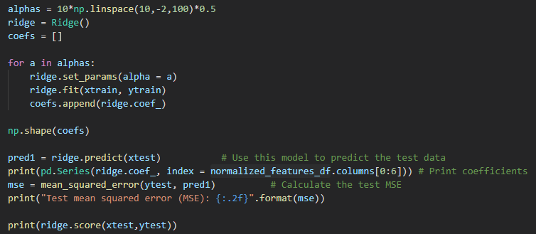
Ridge regression
Ridge regression is a model tuning method that is used to analyze any data that suffers from multicollinearity. This method performs L2 regularization. If there is an issue with multicollinearity , least-squares are unbiased, and variances are large then this results in predicted values being far off from the actual data.

Slide 9
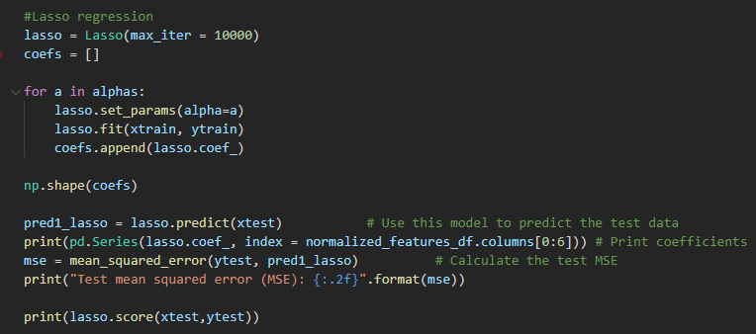
Lass Regression
Lasso regression is a regularization technique. It obtains the subset of predictors that minimizes prediction error. This model uses shrinkage. Shrinkage is where data values are shrunk towards a central point as the mean. The lasso procedure encourages simple, sparse models.

Slide 10
Experiments
We conducted experiments to find the best alpha value to plug into our models by manipulating the alpha values in the Ridge regression & Lasso regression models then analyzing the models' predictive results.
Alpha values are a tuning parameter that determines the weights to be used in the regression model.
To be specific, the L2 norm term in Ridge regression is weighted by the regularization parameter alpha.
Alpha is a parameter for regularization term, aka penalty term, that combats overfitting by constraining the size of the weights. Increasing alpha may fix high variance (a sign of overfitting) by encouraging smaller weights, resulting in a decision boundary plot that appears with lesser curvatures.

Slide 11
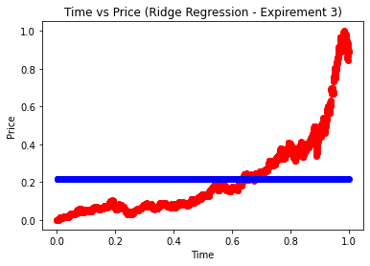
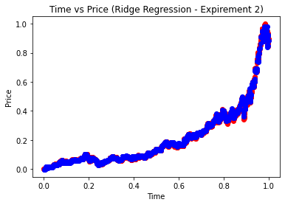
Experiments
Through tuning the alpha value of the models which were trained with the train set, we began to make observations of the variance in predictive capacity of each model.
We observed that larger alpha values in the Ridge regression models impacted the models' predictive capability negatively by under-fitting the training data.
We observed a figurative sweet spot in the three to five alpha value range wherein the models were appropriate-fitting.

Slide 12
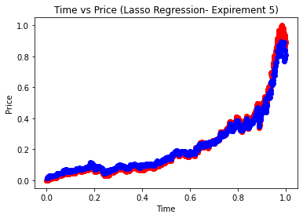
Experiments
When tuning the Lasso regression models via their alpha parameter, we observed the alpha value to have minimal effect on the models' predictive capability.
Although the Lasso regression models proved to make accurate predictions, through further analysis & comparison (via calculating & comparing the different models MSE & R2 Score) we found that the finely tuned Ridge regression models were superior.

Slide 13

Final Approach
Our best model was the fourth of the ridge regressions.
It had an alpha value of 0.
It had an MSE of 5.352342598132385e⁻²⁹.
It had an R2 Score of 0.9997577221552572.
After some research we found that when you pick 0 for the alpha parameter in either Lasso and Ridge, you are basically fitting a linear regression, because there is no penalty applied on the OLS part of the formula.
The sklearn documentation actually discourages running these models with an alpha = 0 argument due to computational complications. We have not observed a case when it caused any computational problems. We have found it to give the same results as a LinearRegression model.
Actual Data = Red
Predicted Data = Blue

Slide 14
Summary of the Results
We decided to compare the results of our models using their R2 score and the MSE. The r2 score varies between 0 and 100%. R2 Score can be defined as the (total variance explained by model) / (total variance). So, if it is 100%, the two variables are perfectly correlated, i.e., with no variance at all. A low value would show a low level of correlation, meaning a regression model that is not valid, but not in all cases.
Mean square error (MSE) is the average of the square of the errors. The larger the number the larger the error. Error in this case means the difference between the observed values y1, y2, y3, … and the predicted ones pred(y1), pred(y2), pred(y3), … We square each difference (pred(yn) – yn)) ** 2 so that negative and positive values do not cancel each other out.
Ridge regression 2
MSE: 0.000012
R2 Score: 0.99
Lasso regression 1
MSE: 0.000606
R2 Score: 0.987
Ridge regression 1
MSE: 0.00000022
R2 Score: 0.99
Ridge regression 3
MSE: 0.049
R2 Score: 0
Ridge regression 4
MSE: 5.4e-29
R2 Score: 1.0
Lasso regression 2
MSE: 0.00606
R2 Score: 0.987

Slide 15
Conclusion
In this project, we have trained a couple of machine learning algorithms to predict stock prices. After comparing the metrics of the models' we found actual trend line and predicted trend line indicate that the Ridge regression model is the best fit model that we can use to predict the stock price.
After tuning the Ridge regression model with various alpha/lambda values, the model is enhanced. Through our work we can deduce that it is most likely impossible to develop a model whose prediction capacity is 99% accurate since there are multiple variables that affect the price of a company's stock. Nevertheless, we could at the very least predict the general trendline of a stocks share price by taking different factors into consideration.

